Slide 1

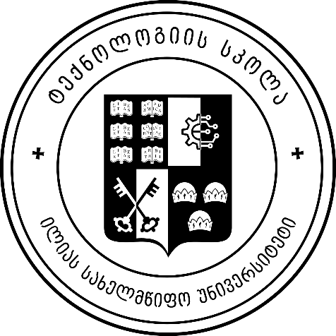
Introduction to Operating Systems
Introduction
ILIA STATE UNIVERSITY
Paata Gogishvili
Doctor of Informatics
Associate Professor
School of Technology
September 27, 2023
Faculty of Business, Technology and Education

Slide 2
Lecture Topics
Operating Systems Overview and Common Concepts
History of OS (Windows, Linux, IOS, Android, WebOS, ChromeOS)
Operating System Structure
ILIA STATE UNIVERSITY

Slide 3
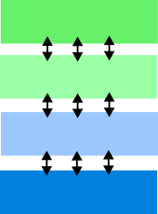
Operating Systems Overview and Common Concepts
An operating system (OS) is a software that manages computer hardware and software resources and provides services for computer programs. It is a crucial component of a computer system as it acts as an interface between the user, application software, and the computer hardware.
User
Application
OS
Hardware
ILIA STATE UNIVERSITY

Slide 4
Why we need OS between hardware and applications?
To make Execute user programs and make solving user problems easier
To make the computer system convenient to use;
To use the computer hardware in an efficient manner
ILIA STATE UNIVERSITY

Slide 5
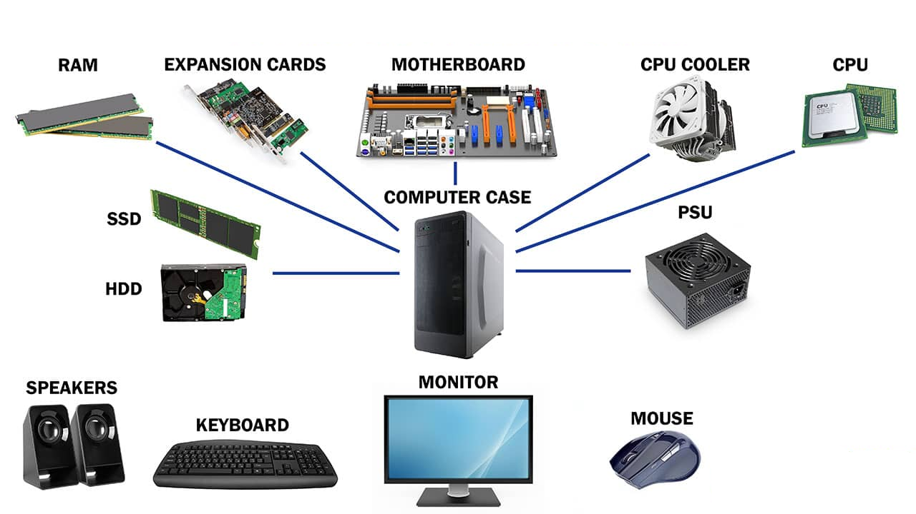
Hardware
ILIA STATE UNIVERSITY

Slide 6
Working with hardware is hard
Working with hardware is hard because it requires precise and specific instructions specific to that hardware component.
Without an operating system, each application program would need to directly communicate with the hardware, which can be complex and time-consuming. Moreover, it can lead to conflicts and inefficiencies as different programs may require different hardware resources at the same time.
ILIA STATE UNIVERSITY

Slide 7

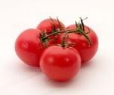


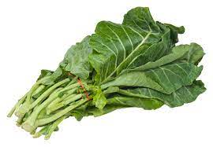
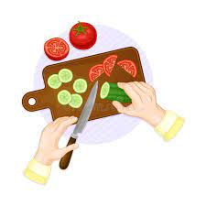
Scenario 1
Suppose we want to eat salad in the afternoon.
What should we do?
1. We should go to store
2. Buy tomato, cucumber, greens.
3. Bring ingredients to home.
4. Wash and cut them.
ILIA STATE UNIVERSITY

Slide 8

Scenario 2
Suppose we want to eat salad in the afternoon.
What should we do?
1. We can tell our cook to prepare salad.
ILIA STATE UNIVERSITY

Slide 9
Scenario 2
Suppose we want to eat salad in the afternoon.
What should we do?
1. We can tell our cook to prepare salad.
ILIA STATE UNIVERSITY
The name of our cook is OS

Slide 10
Example of the restaurant
In a busy restaurant, customers (applications and users) place various orders. These orders can be complex, like a customized pizza or a special dietary request (tasks that hardware must perform). Without a restaurant manager (OS), the kitchen staff (hardware) would have to deal directly with these complex orders. This could lead to chaos, misunderstandings, and inefficiencies.
With OS: The restaurant manager (OS) takes orders from customers (applications) and communicates them to the kitchen staff (hardware) in a standardized way. It organizes and prioritizes the orders, ensuring that each one is executed correctly and efficiently. This reduces the complexity for the kitchen staff, allowing them to focus on cooking (processing tasks) without worrying about the specifics of each order.
ILIA STATE UNIVERSITY

Slide 11
Example of the printer
Example: The OS and a Printer
Imagine you have a basic printer that can print documents. Without an OS, interacting with this printer would be a complex and frustrating experience.
No OS Scenario:
Every time you want to print a document, you would need to manually control the printer's hardware.
You'd have to send electrical signals to the printer components (like the print head) to specify what to print, how to format it, and when to start and stop.
You'd also need to ensure that the printer doesn't receive conflicting commands from multiple sources simultaneously.
In this scenario, printing a simple document becomes a daunting task, requiring in-depth knowledge of the printer's hardware and constant monitoring to prevent errors.
ILIA STATE UNIVERSITY

Slide 12
Example of the printer
With an OS:
The OS acts as an intermediary between you and the printer.
When you want to print a document, you simply send a print command to the OS.
The OS takes care of formatting the document, managing the printer's hardware, and ensuring that your print job doesn't interfere with others.
You don't need to worry about the technical details of how the printer works; the OS abstracts all the complexity.
With an OS in place, printing becomes a user-friendly and straightforward process. You don't have to be a printer expert to produce documents. The OS simplifies the interaction by providing a standardized interface.
ILIA STATE UNIVERSITY

Slide 13
Main goal of OS
Manages, allocates resources
CPU (execution time)
Memory Space
Disk / File storage
I/O Devices
Controls
Prevent incorrect use of hardware
Security / Protection
ILIA STATE UNIVERSITY

Slide 14
Second Main goal of OS is Abstraction
The job of agro shop is to sell individual ingredients. It has no idea about salad.
The benefit from our cook is knowledge about concept of salad.
There is many good abstractions on OS level.
ILIA STATE UNIVERSITY

Slide 15
History of OS relates to history of hardware
Year | Mean Processor Frequency | Mean CPU Cores | Mean Internet Speed | Mean RAM | Mean HD Capacity
1970 | 0.06 MHz | 1 | N/A | N/A | N/A
1975 | 0.75 MHz | 1 | N/A | N/A | N/A
1980 | 4.77 MHz | 1 | N/A | N/A | N/A
1985 | 8 MHz | 1 | N/A | N/A | N/A
1990 | 33 MHz | 1 | N/A | 1 MB | 120 MB
1995 | 66 MHz | 1 | 28.8 kbps | 8 MB | 1 GB
2000 | 700 MHz | 1 | 56 kbps | 128 MB | 20 GB
2005 | 2.2 GHz | 1.8 | 1 Mbps | 512 MB | 160 GB
2010 | 2.93 GHz | 2.5 | 10 Mbps | 2 GB | 500 GB
2015 | 3.5 GHz | 4 | 50 Mbps | 8 GB | 1 TB
2020 | 4.4 GHz | 6 | 100 Mbps | 16 GB | 2 TB
ILIA STATE UNIVERSITY

Slide 16
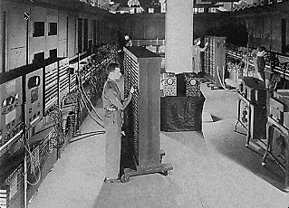
ENIAC - 1945-55
The machine was designed by Eckert and Mauchly.
The ENIAC filled an entire room, weighed 30 tons, and consumed 200 kilowatts of power.
Vacuum tubes, over 19,000 of them, were the principal elements in the computer's circuitry. It also had fifteen hundred relays and hundreds of thousands of resistors, capacitors, and inductors. All this electronics were held in forty-two panels nine feet tall, two feet wide, and one foot thick. They were arranged in a "U" shape, with three panels on wheels so they could be moved around. An IBM card reader and card punch were used respectively for input and output.
ILIA STATE UNIVERSITY

Slide 17
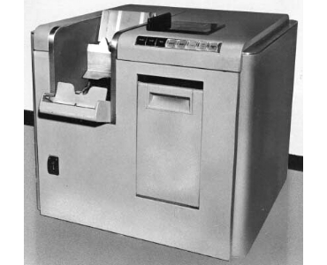
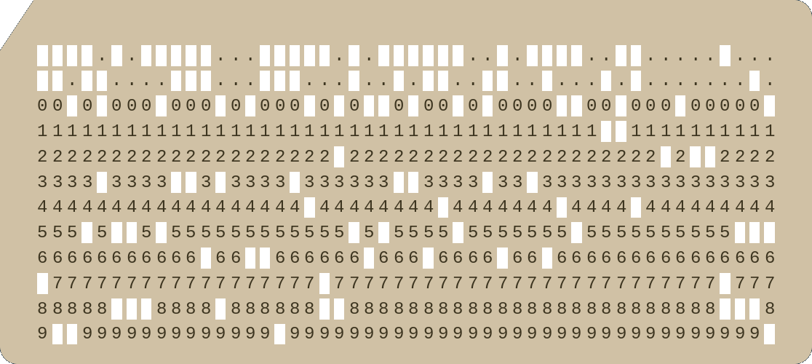
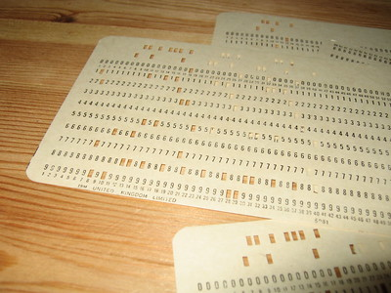
Card Reader
Storage media was paper cards.
ILIA STATE UNIVERSITY

Slide 18
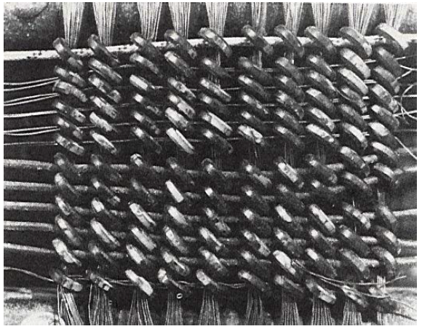
Old Memory
The first magnetic core memory, from the IBM 405 Alphabetical Accounting Machine.
Core Memory stored data as magnetization in iron rings. Iron “cores” woven into a 2-dimensional mesh of wires.
ILIA STATE UNIVERSITY

Slide 19
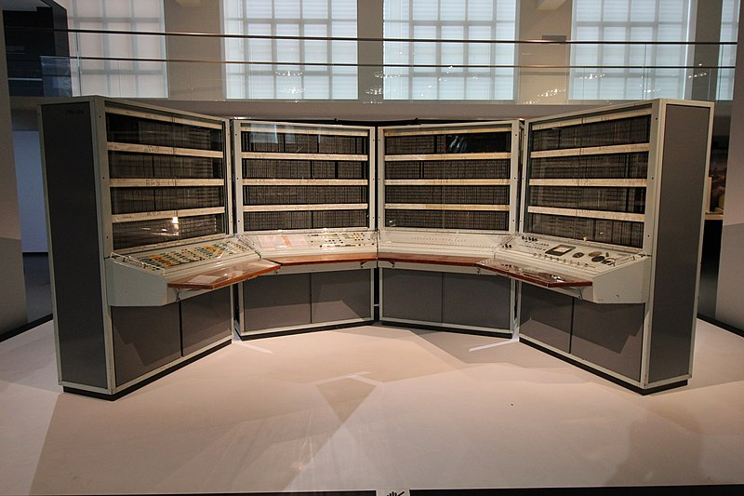
BESM - 1950–60
BESM (БЭСМ) is the name of a series of Soviet mainframe computers built in 1950–60s. The name is an acronym for "Большая Электронно-Счётная Машина", literally "Large Electronic Computing Machine".
The machine used approximately 5,000 vacuum tubes. It had external storage: four magnetic tape units of 30,000 words each, and fast magnetic drum storage with a capacity of 5120 words and an access rate of 800 words/second. The computer was capable of performing 8–10 KFlops. The energy consumption was approximately 30 kW, not accounting for the cooling systems.
ILIA STATE UNIVERSITY

Slide 20
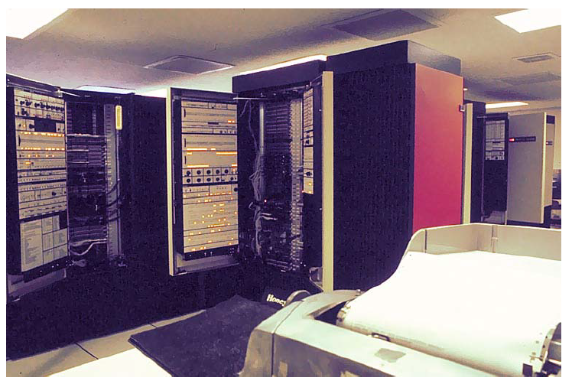
The Multics System (~ 1976)
“We usually ran the machine with doors open so the operators could see the AQ register display, which gave you an idea of the machine load, and for convenient access to the EXECUTE button, which the operator would push to enter BOS if the machine crashed.”
ILIA STATE UNIVERSITY

Slide 21
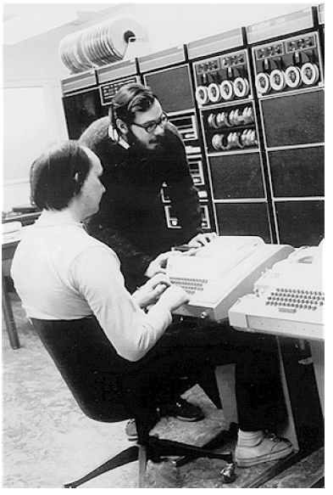
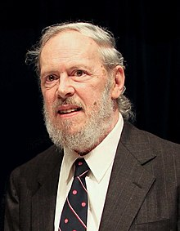
Ritchie & Thompson at PDP 11 - 1970
Unix needed 16 KB.
users could only get 8Kb for their application.
Unix was mini-OS at that time.
ILIA STATE UNIVERSITY

Slide 22
C and Unix
Ritchie and Thompson were two computer scientists who were key contributors to the development of the PDP-11 computer system.
Dennis Ritchie was a computer scientist who co-created the C programming language, along with Ken Thompson. Ritchie also helped develop the Unix operating system, which was originally designed to run on the PDP-11 computer.
Ken Thompson was also a computer scientist who worked on the development of Unix and the C programming language with Ritchie. Thompson was instrumental in creating the first version of the Unix operating system on the PDP-11 in 1970, and he continued to work on Unix development throughout the 1970s and 1980s.
Together, Ritchie and Thompson played a significant role in the development of the PDP-11 and the Unix operating system, which had a major impact on the field of computer science and the development of modern computing systems.
ILIA STATE UNIVERSITY

Slide 23
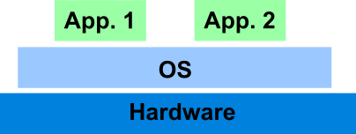
OS Problems of that time:
• A waiting process blocks everything else on the machine.
(Seemingly) Simple hack:
• run more than one process at once;
• when one process blocks, switch to another.
A couple of problems: what if a program
• does infinite loops or
• starts randomly scribbling on memory?
OS adds protection:
• Interposition
• Preemption
• Privilege
ILIA STATE UNIVERSITY

Slide 24
From 1981
Computer costs $1K, Programmer costs $100K/year
If you can make someone 1% more efficient by giving them a computer, it’s worth it
Use computers to make people more efficient
Personal computing:
Computers cheap, so give everyone a PC
Limited Hardware Resources Initially:
OS becomes a subroutine library
One application at a time (MSDOS, CP/M, …)
Eventually PCs become powerful:
OS regains all the complexity of a “big” OS
multiprogramming, memory protection, etc (NT,OS/2)
ILIA STATE UNIVERSITY

Slide 25
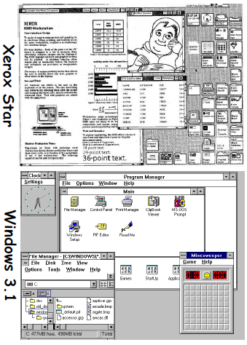
From 1981
Xerox Star: 1981
Originally a research project (Alto)
First “mice”, “windows”
Apple Lisa/Machintosh: 1984
“Look and Feel” suit 1988
Microsoft Windows:
Win 1.0 (1985)
Win 3.1 (1990)
Win 95 (1995)
Win NT (1993)
Win 2000 (2000)
Win XP (2001)
ILIA STATE UNIVERSITY

Slide 26
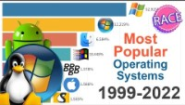
Most popular operating systems
https://www.youtube.com/watch?v=o14-gCNRwR8
ILIA STATE UNIVERSITY

Slide 27
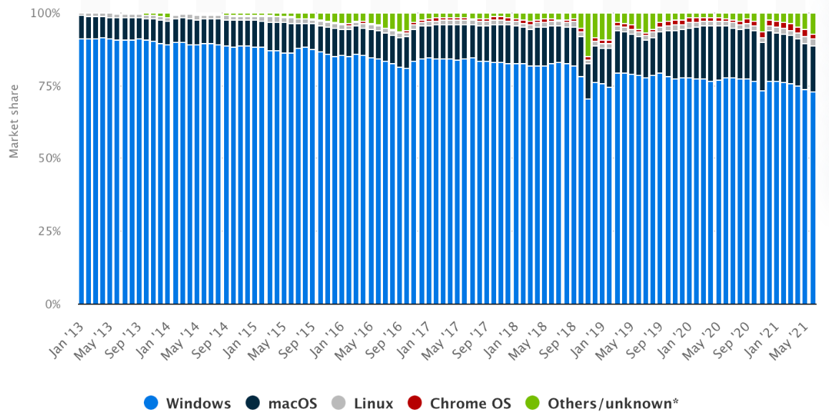
Most Used Desktop PC OSs
ILIA STATE UNIVERSITY
Global Market Share of Desktop PC OS from January 2013 to June 2021

Slide 28
Operating System Structure
It is easier to create an operating system in pieces, much as we break down larger issues into smaller, more manageable subproblems. Every segment is also a part of the operating system. Operating system structure can be thought of as the strategy for connecting and incorporating various operating system components within the kernel.
ILIA STATE UNIVERSITY
Simple Structure
Monolithic Structure
Layered Approach Structure
Micro-Kernel Structure
Exo-Kernel Structure
Virtual Machines

Slide 29
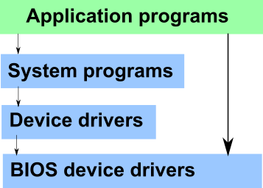
Simple structure
It is the most straightforward operating system structure, but it lacks definition and is only appropriate for usage with tiny and restricted systems. Since the interfaces and degrees of functionality in this structure are clearly defined, programs are able to access I/O routines, which may result in unauthorized access to I/O procedures.
ILIA STATE UNIVERSITY

Slide 30
MS DOS is example of Simple Structure OS
There are four layers that make up the MS-DOS operating system, and each has its own set of features.
These layers include ROM BIOS device drivers, MS-DOS device drivers, application programs, and system programs.
The MS-DOS operating system benefits from layering because each level can be defined independently and, when necessary, can interact with one another.
When a user program fails, the operating system as whole crashes.
Because MS-DOS systems have a low level of abstraction, programs and I/O procedures are visible to end users, giving them the potential for unwanted access.
ILIA STATE UNIVERSITY

Slide 31
Advantages and disadvantages
Advantages:
Because there are only a few interfaces and levels, it is simple to develop.
Because there are fewer layers between the hardware and the applications, it offers superior performance.
Disadvantages:
The entire operating system breaks if just one user program malfunctions.
Since the layers are interconnected, and in communication with one another, there is no abstraction or data hiding.
The operating system's operations are accessible to layers, which can result in data tampering and system failure.
ILIA STATE UNIVERSITY

Slide 32
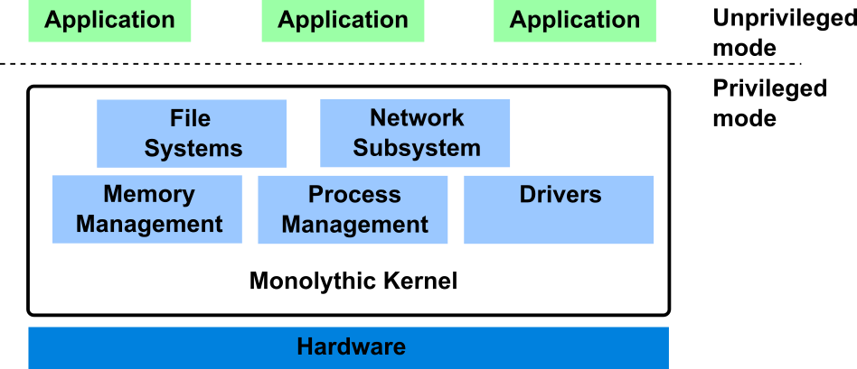
Monolithic Structure
The monolithic operating system controls all aspects of the operating system's operation, including file management, memory management, device management, and operational operations.
ILIA STATE UNIVERSITY

Slide 33
Advantages and disadvantages
Advantages:
Because layering is unnecessary and the kernel alone is responsible for managing all operations, it is easy to design and execute.
Due to the fact that functions like memory management, file management, process scheduling, etc., are implemented in the same address area, the monolithic kernel runs rather quickly when compared to other systems. Utilizing the same address speeds up and reduces the time required for address allocation for new processes.
Disadvantages:
The monolithic kernel's services are interconnected in address space and have an impact on one another, so if any of them malfunctions, the entire system does as well.
It is not adaptable. Therefore, launching a new service is difficult.
ILIA STATE UNIVERSITY

Slide 34
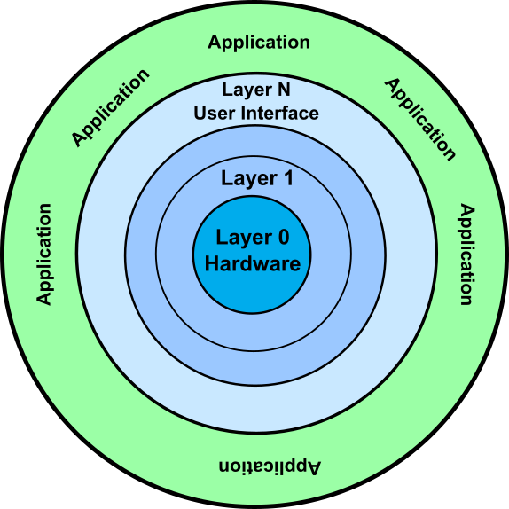
Layered Structure
The OS is separated into layers or levels in this kind of arrangement. Layer 0 (the lowest layer) contains the hardware, and layer 1 (the highest layer) contains the user interface (layer N). These layers are organized hierarchically, with the top-level layers making use of the capabilities of the lower-level ones.
ILIA STATE UNIVERSITY

Slide 35
Advantages and disadvantages
Advantages:
Work duties are separated since each layer has its own functionality, and there is some amount of abstraction.
Debugging is simpler because the lower layers are examined first, followed by the top layers.
Disadvantages:
Performance is compromised in layered structures due to layering.
Construction of the layers requires careful design because upper layers only make use of lower layers' capabilities.
ILIA STATE UNIVERSITY

Slide 36
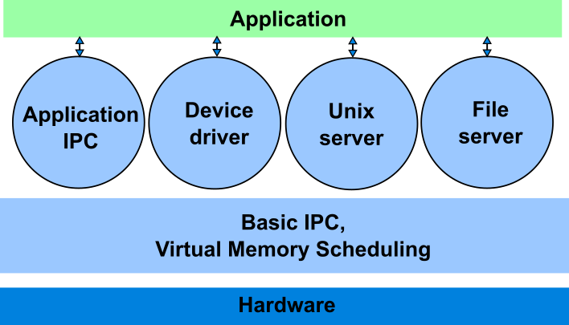
Micro-kernel Structure
The operating system is created using a micro-kernel framework that strips the kernel of any unnecessary parts. Systems and user applications are used to implement these optional kernel components. So, Micro-Kernels is the name given to these systems that have been developed.
ILIA STATE UNIVERSITY

Slide 37
Advantages and disadvantages
Advantages:
It enables portability of the operating system across platforms.
Due to the isolation of each Micro-Kernel, it is reliable and secure.
The reduced size of Micro-Kernels allows for successful testing.
The remaining operating system remains unaffected and keeps running properly even if a component or Micro-Kernel fails.
Disadvantages:
The performance of the system is decreased by increased inter-module communication.
The construction of a system is complicated.
ILIA STATE UNIVERSITY

Slide 38
Exokernel OS
An operating system called Exokernel was created at MIT with the goal of offering application-level management of hardware resources. The exokernel architecture's goal is to enable application-specific customization by separating resource management from protection. Exokernel size tends to be minimal due to its limited operability.
Exokernel operating systems have a number of features, including:
Enhanced application control support.
Splits management and security apart.
A secure transfer of abstractions is made to an unreliable library operating system.
Brings up a low-level interface.
Operating systems for libraries provide compatibility and portability.
ILIA STATE UNIVERSITY

Slide 39
Advantages and disadvantages
Advantages:
Application performance is enhanced by it.
Accurate resource allocation and revocation enable more effective utilisation of hardware resources.
New operating systems can be tested and developed more easily.
Every user-space program is permitted to utilise its own customised memory management.
Disadvantages:
A decline in consistency
Exokernel interfaces have a complex architecture.
ILIA STATE UNIVERSITY

Slide 40
Virtual Machines
The hardware of our personal computer, including the CPU, disc drives, RAM, and NIC (Network Interface Card), is abstracted by a virtual machine into a variety of various execution contexts based on our needs, giving us the impression that each execution environment is a separate computer.
HyperV, VmWare, VirtualBox, Containers, …
ILIA STATE UNIVERSITY

Slide 41
Advantages and disadvantages
Advantages of Virtual Machines:
Due to total isolation between each virtual machine and every other virtual machine, there are no issues with security.
A virtual machine may offer an architecture for the instruction set that is different from that of actual computers.
Simple availability, accessibility, and recovery convenience.
Disadvantages of Virtual Machines:
Depending on the workload, operating numerous virtual machines simultaneously on a host computer may have an adverse effect on one of them.
When it comes to hardware access, virtual computers are less effective than physical ones.
ILIA STATE UNIVERSITY

